Slide 1
Docker for Developer
By SAK

Slide 2
YOUR EXPECTATION

Slide 3
OBJECTIVE
เข้าใจว่า ทำไมต้องใช้ Docker
เข้าใจ Component ของ Docker เบื้องต้น
เข้าใจคำสั่งใน Docker file / Docker Compose เบื้องต้น
สามารถ Set/ใช้งาน Dev environment ได้

Slide 4
AGENDA
Problems
Solutions
What is docker
Element of docker
Docker interaction
Demo – Hello world
Demo – Dockerfile
Demo – Docker Compose File
My Hero

Slide 5
Problems
Dev Machine
PHP 5.6
Nginx
QA Server
PHP 5.6
Extension A,B
PRODUCTION Server
PHP 5.1
Extension A,B
Extension A,B
MYSQL 8.0
IIS 7.0
MYSQL 5.6
IIS 8.0
MYSQL 5.1
WD 10
WD S 2008
WD S 2012 R2

Slide 6
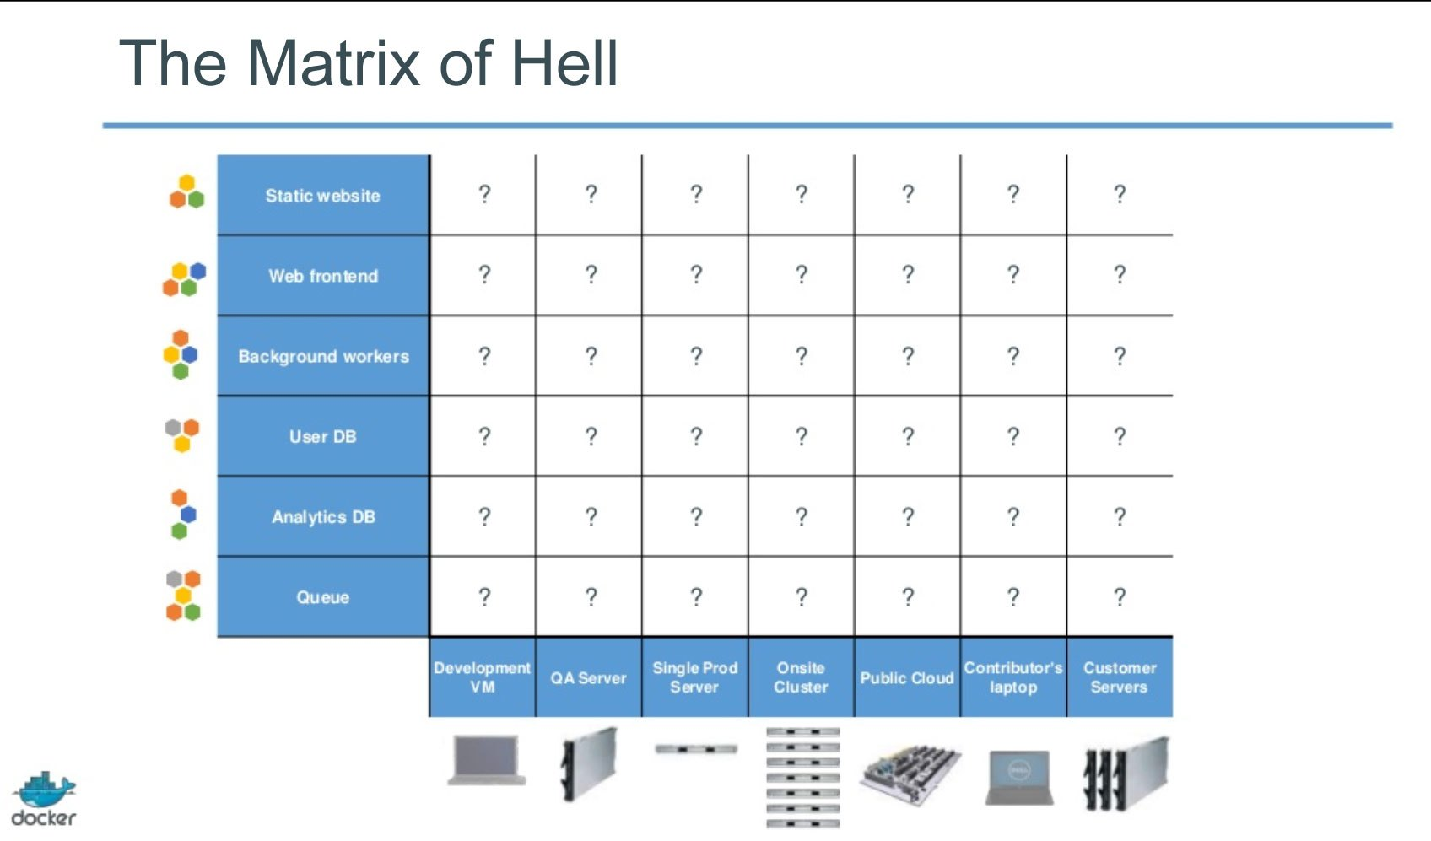

Slide 7
Technology change so fast !!!
DEV
PHP 7.2
Nginx 1.10
INFRA

Slide 8
How to solve this problems ???

Slide 9
Solution
VM
Not lightweight
Vagrant
more lightweight
Docker
lightweight
use much more resources
portable
more portable
“Development Environments” based-on VirtualBox

Slide 10
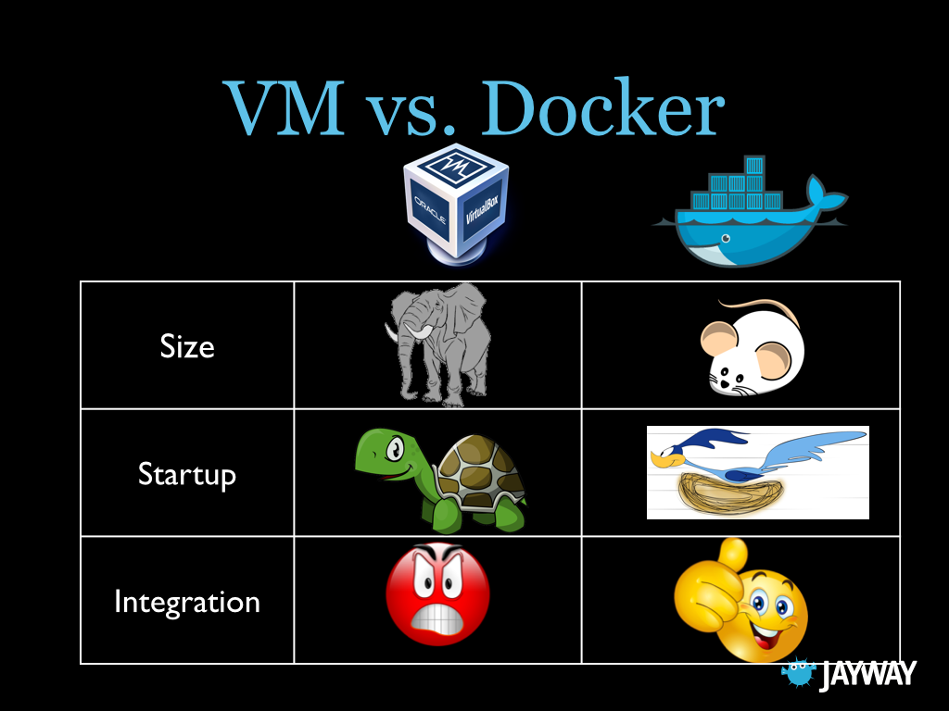

Slide 11
Docker
Create environment compatible for your software
Separate disk space for each project
Easy to implementation
Easy to deploy and portability

Slide 12
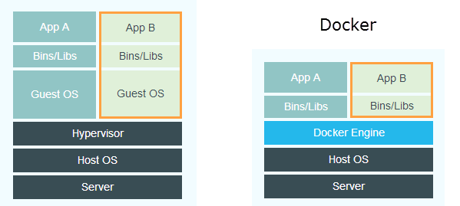
VM

Slide 13
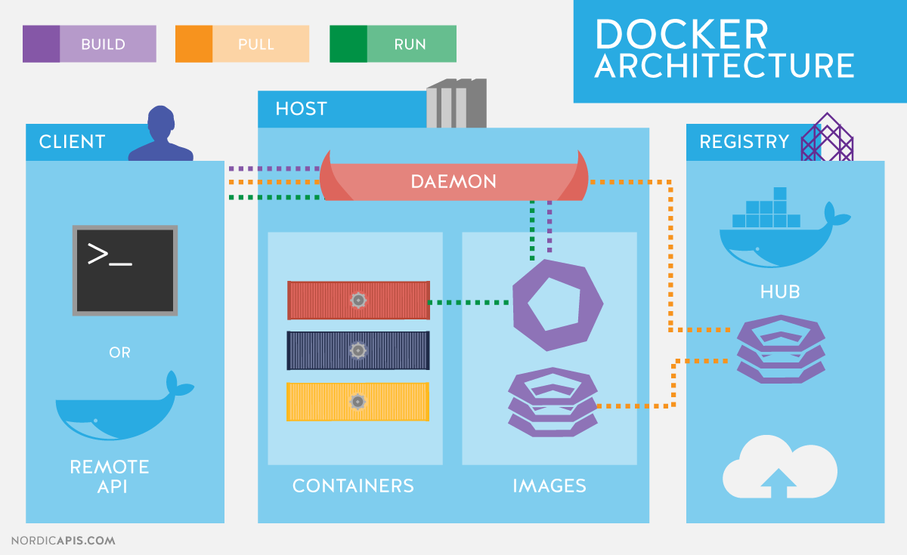

Slide 14
Element of Docker
Image (A template of container)
Container (piece of software in a complete filesystem that contains everything)
Linux or windows inside
Registry (The repository of images)
Create from image
Installed yours app and environment
Build from Dockerfile or Container
Can be read only
Template of container
Running process
Can modify/access after up and running
Commit change to create image
Contain images
Image on registry can pull from any location

Slide 15
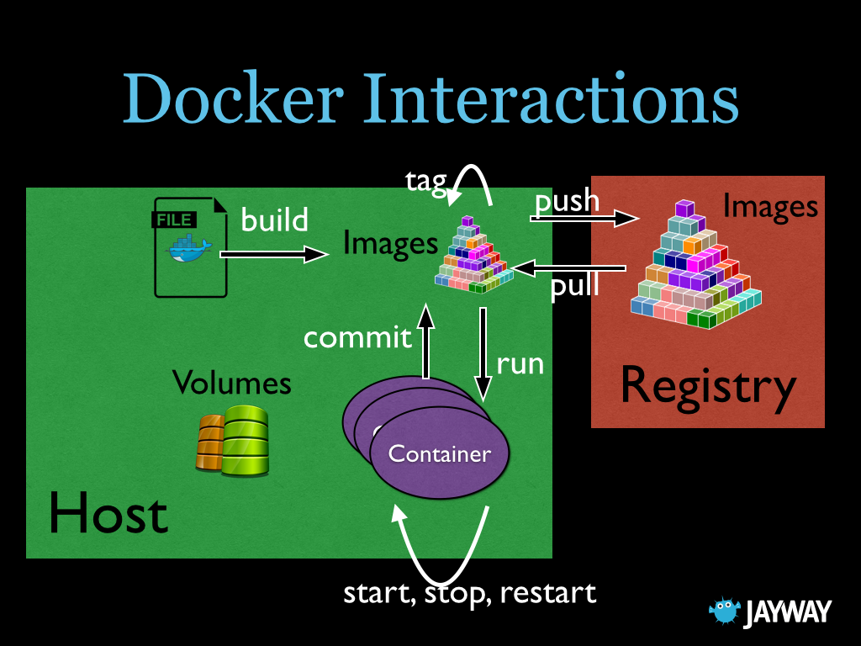

Slide 16
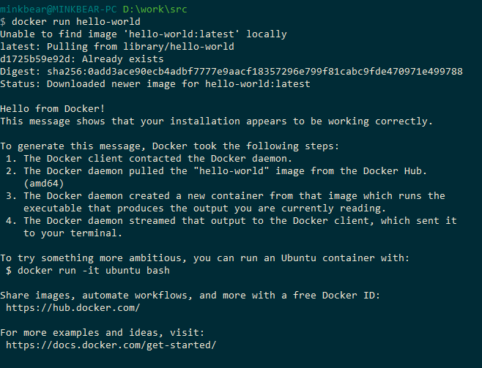
Docker Hello-world

Slide 17
DEMO - Dockfile
#Specify base image (can be a name fetched from here: https://hub.docker.com/explore/)
FROM node:6.3
#Run command that here happens to create a directory
RUN mkdir -p /usr/applicationSrc
#Set the working directory when started
WORKDIR /usr/applicationSrc
#Run this command when booted
CMD [ "npm", "start" ]

Slide 18
DEMO – Build image
docker build -t my_image .

Slide 19
DEMO – Create a container
docker create --name my_container_1 -p 1234:8000 -v /d/work/src/docker-for-busy-people:/usr/applicationSrc my_image

Slide 20
DEMO – Start, Log, Access
docker start my_container_1
docker logs my_container_1
http://localhost:1234/

Slide 21
DEMO – Create a container 2
docker run --name my_container_2 --env SPECIAL_PORT=1234 -p 8000:1234 -v /d/work/src/docker-for-busy-people:/usr/applicationSrc my_image
http://localhost:8000/

Slide 22
DEMO – Stop, Delete containers, Delete Images
docker stop my_container_1 my_container_2
docker rm my_container_1 my_container_2
docker rmi my_image

Slide 23
Demo - Docker Compose
RUN APP IN ONE COMMAND
docker-compose up
http://localhost:8000/
http://localhost:8001/
docker-compose ps
docker-compose stop
docker-compose restart
docker-compose down
docker-compose build

Slide 24

Hero - Laradock

Slide 25
Hero - Laradock
Easy switch between PHP versions: 7.2, 7.1, 5.6
Choose your favorite database engine: MySQL, Postgres, MariaDB…
Run your own combination of software: Memcached, HHVM, Beanstalkd…
Every software runs on a separate container: PHP-FPM, NGINX, PHP-CLI…
Easy to customize any container, with simple edit to the Dockerfile.
All Images extends from an official base Image. (Trusted base Images).
Pre-configured NGINX to host any code at your root directory.
Can use Laradock per project, or single Laradock for all projects.
Easy to install/remove software’s in Containers using environment variables.
Clean and well structured Dockerfiles (Dockerfile).
Latest version of the Docker Compose file (docker-compose).
Everything is visible and editable.
Fast Images Builds.

Slide 26
Hero - Laradock
Database Engines: MySQL - MariaDB - Percona - MongoDB - Neo4j - RethinkDB - MSSQL - PostgreSQL - Postgres-PostGIS.
Database Management: PhpMyAdmin - Adminer - PgAdmin
Cache Engines: Redis - Memcached - Aerospike
PHP Servers: NGINX - Apache2 - Caddy
PHP Compilers: PHP FPM - HHVM
Message Queueing: Beanstalkd - RabbitMQ - PHP Worker
Queueing Management: Beanstalkd Console - RabbitMQ Console
Random Tools: Mailu - HAProxy - Certbot - Blackfire - Selenium - Jenkins - ElasticSearch - Kibana - Grafana - Gitlab - Mailhog - MailDev - Minio - Varnish - Swoole - NetData - Portainer - Laravel Echo - Phalcon…

Slide 27
Hero - Laradock
Php-fpm
Nginx
Mysql
Php-worker
Redis
Workspace

Slide 28
Start with Laradock
Enable Virtualization
hold SHIFT and click Restart
Troubleshoot > Advanced Options > UEFI Firmware Settings
Enable Hyperv
CMD (admin) => enable_hyberv.bat
DISM /Online /Enable-Feature /All /FeatureName:Microsoft-Hyper-V

Slide 29
Start with Laradock (Cont)
Installl docker
https://hub.docker.com/editions/community/docker-ce-desktop-windows/

Slide 30
Start with Laradock (Cont)
D:\
|
|___docker_data
|___src
|___project_001
|___project_002
|___project_003
|___laradock
Folder Structure
Data
Source code
Set Folder d:\src, d:\docker_data

Slide 31
Start with Laradock (Cont)
Create account => create_dockeruser.bat
net user "DockerUser" “test" /add
net localgroup "Administrators" "DockerUser" /add
WMIC USERACCOUNT WHERE "Name='DockerUser'" SET PasswordExpires=FALSE
WMIC USERACCOUNT WHERE "Name='DockerUser'" SET Passwordchangeable=FALSE
Share folder => grant_dockeruser.bat
icacls "D:\src" /q /c /t /grant DockerUser:F
icacls "D:\docker_data" /q /c /t /grant DockerUser:F

Slide 32
Start with Laradock (Cont)
cd d:\src
git clone https://github.com/laradock/laradock.git
cd laradock
copy env-example .env
Edit .env

Slide 33
Start with Laradock (Cont)
DATA_PATH_HOST=d:/docker_data
WORKSPACE_TIMEZONE=Asia/Bangkok
PHP_VERSION=7.3
docker-compose up -d nginx mysql
docker-compose exec --user laradock workspace bash
exit
docker-compose stop

Slide 34
Install new project
laravel new test_laravel
Add laradock\nginx\sites\laravel.conf from laravel.conf.example

Slide 35
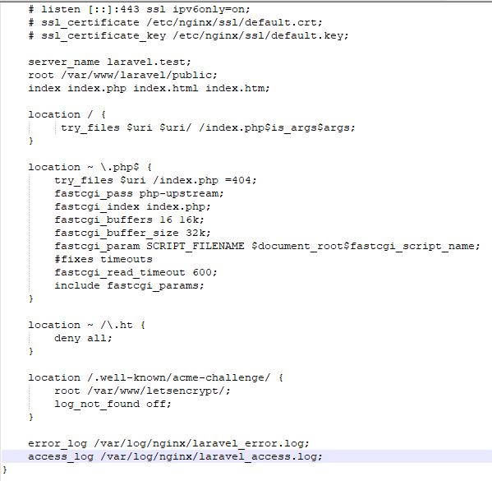
server_name test_laravel.test
root /var/www/test_laravel/public
error_log /var/www/laradock/logs/nginx/test_laravel_error.log;

Slide 36
Edit hosts file
Edit as admin C:\Windows\System32\drivers\etc\hosts
/etc/hosts
127.0.0.1 test_laravel.test
Save hosts file

Slide 37
Install site
docker-compose up –d nginx mysql
docker-compose down
docker-compose exec --user laradock workspace bash

Slide 38
STOP VS DOWN
docker-compose stop
stop your containers, but it won’t remove them
docker-compose down
stop your containers, but it also removes the stopped containers as well as any networks that were created

Slide 39
Change PHP Version
Edit .env PHP_VERSION=5.6
docker-compose build --no-cache php-fpm
docker-compose build --no-cache workspace
docker-compose down
docker-compose up –d nginx mysql

Slide 40
Summary
docker-compose up –d nginx mysql
docker-compose down
docker-compose stop
docker-compose exec --user laradock workspace bash
docker-compose build --no-cache php-fpm

